Slide 1


Network Canvas Duke Social Networks and Health Workshop 2018
Patrick Janulis, PhD
Assistant Professor
Department of Medical Social Sciences

Slide 2


www.networkcanvas.com

Slide 3
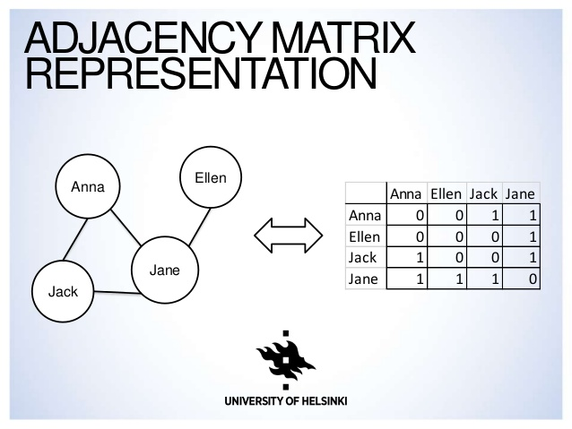
Adjacency Matrix

Slide 4
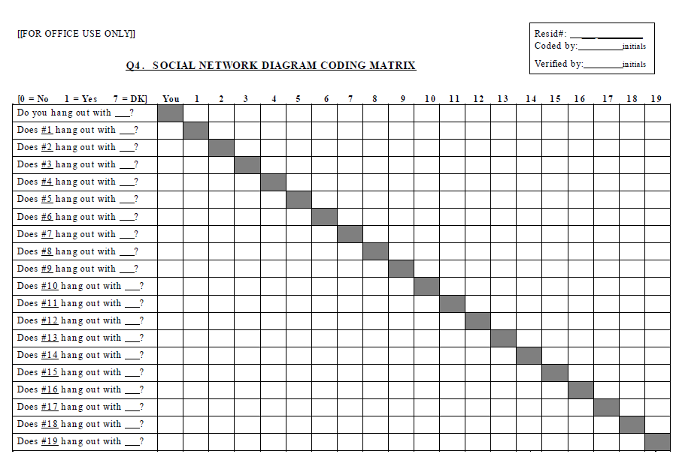

Slide 5
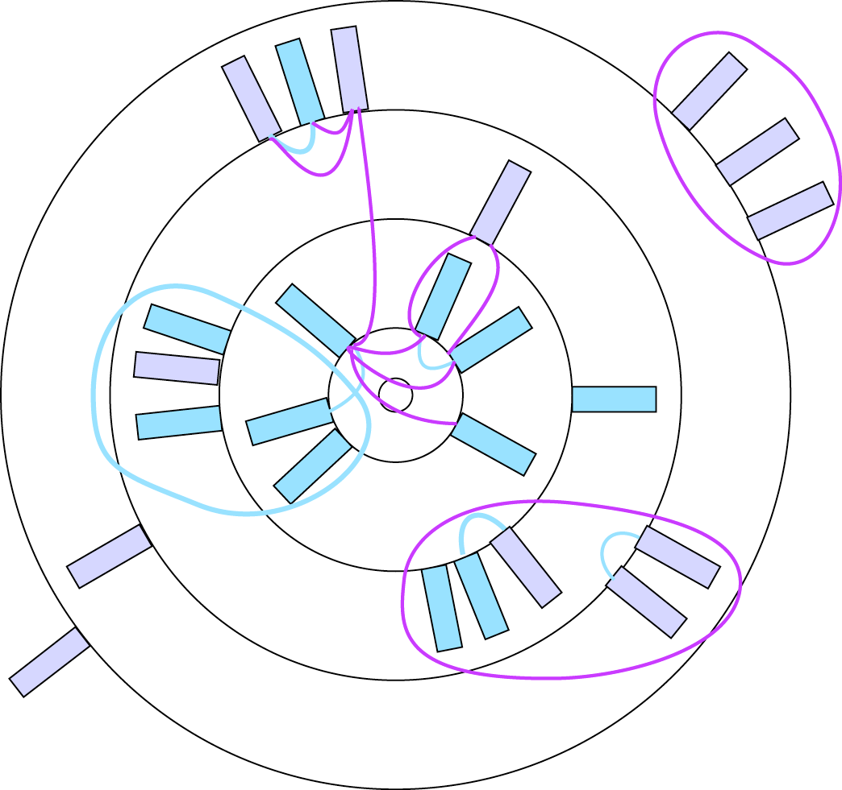
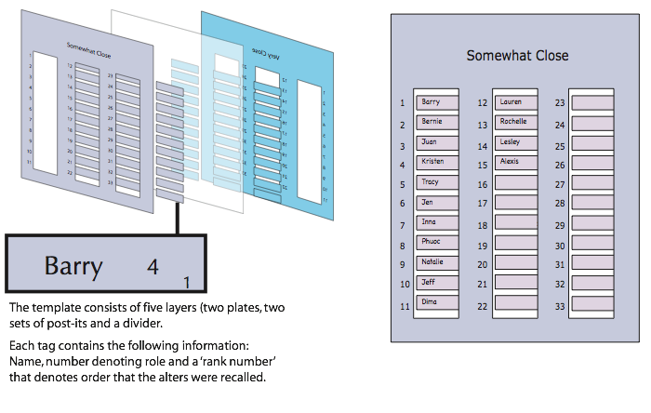
Participant-Aided Sociogram
(Hogan, Carrasco & Wellman, 2007)

Slide 6
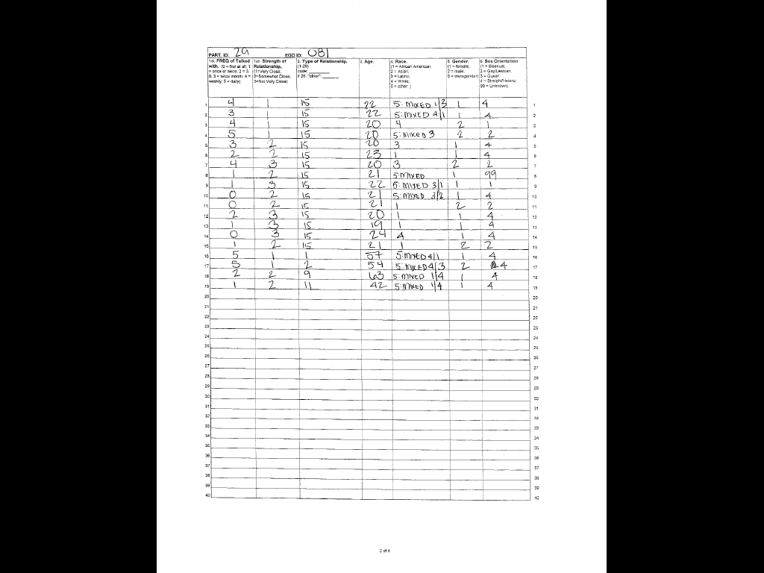
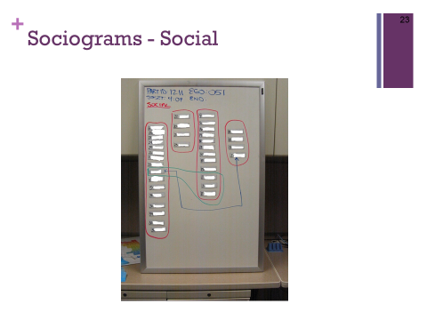

Participant-Aided Sociogram – in LYNC
LYNC

Slide 7

Large cohort study of young men who have sex with men (YMSM) ages 16-29 in Chicago (N > 1000)
Collecting multilevel data:
Network – Social, sexual, drug
Psychosocial – Demographics, mental health, drug and alcohol use, HIV preventive behaviors
Biomedical – Testing for HIV (phylogenetic), STIs, and drug use
Participant visits every 6 months for 5 years

Slide 8
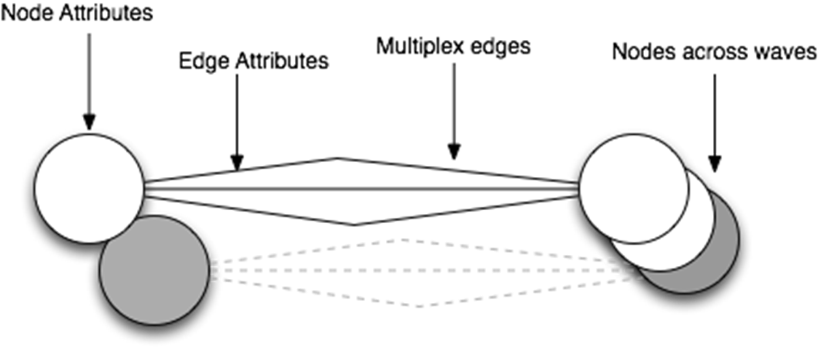
Software Requirements
Must be intuitive and easy for participants
Select, position, and manipulate nodes via touch
Must be able to capture
up to 40 nodes at each time point
alter X alter connections
complex node and edge attributes
dynamic data across waves
skip logic

Slide 9
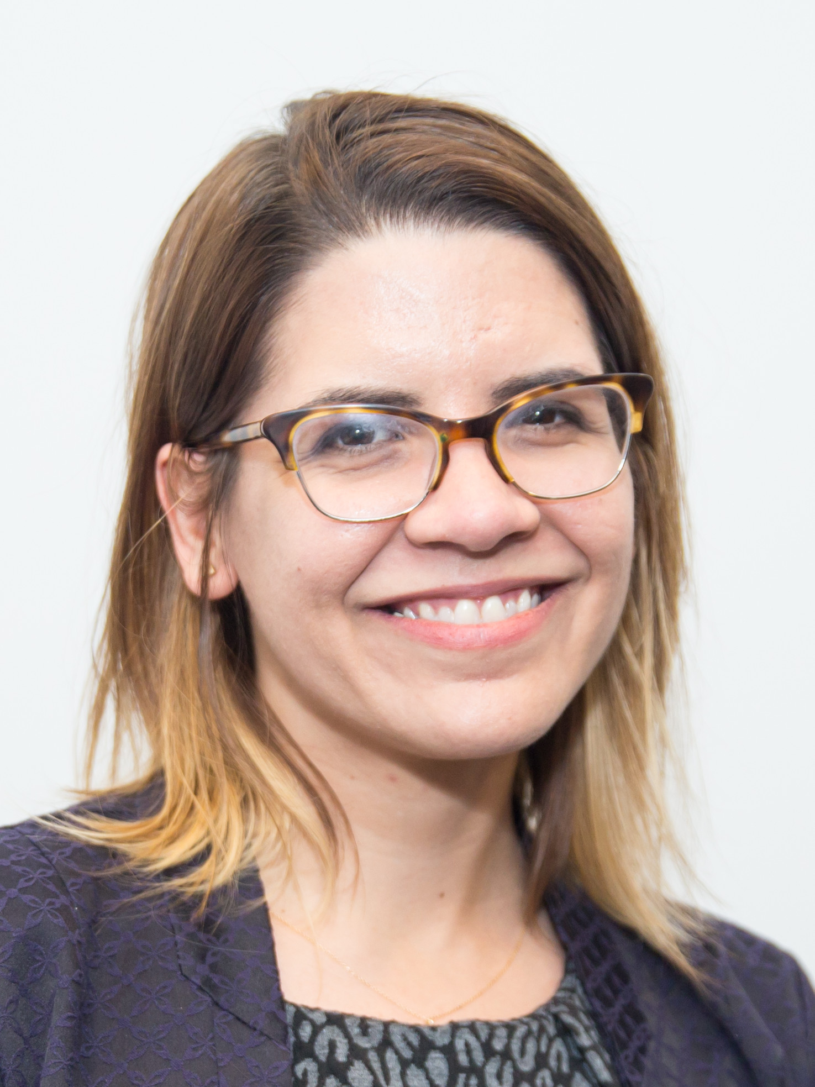
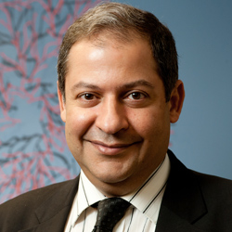

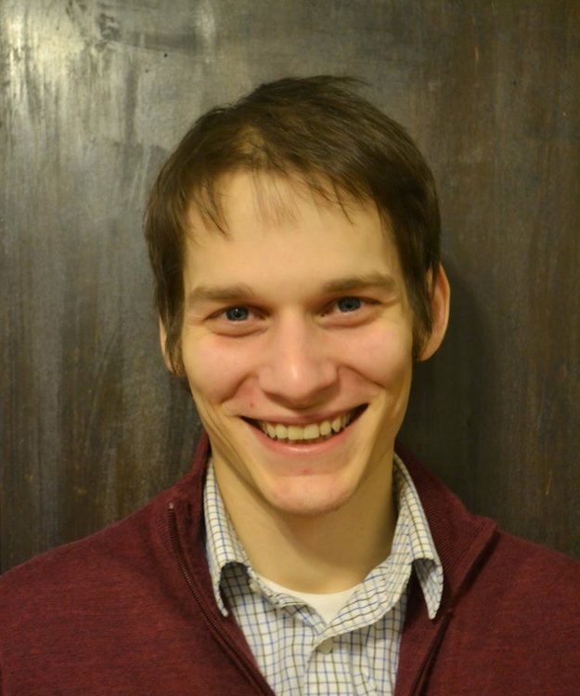

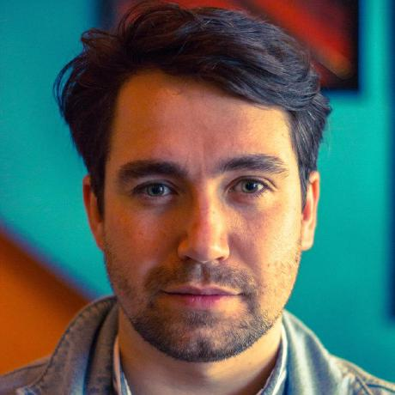
Network-R Development Team
RADAR Network Team Co-Leads
Michelle Birkett, PhD – Co-Investigator
Noshir Contractor, PhD – Co-Investigator
NU Team
Gregory Phillips II, PhD – Assistant Professor
Patrick Janulis, PhD – Assistant Professor
Oxford Team
Bernie Hogan, PhD – Product Manager
Joshua Melville, MSc – Lead Developer

Slide 10
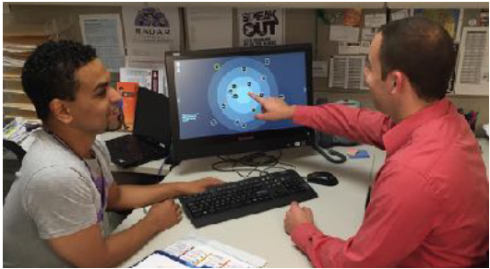
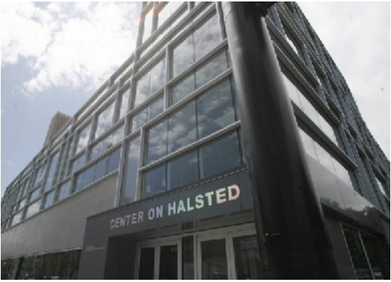
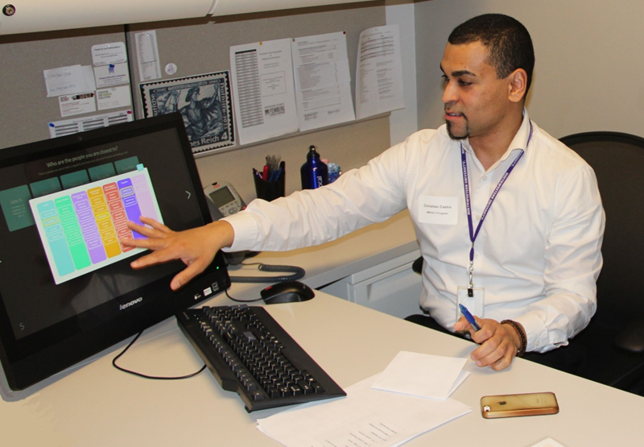
NetCanvas-R

Slide 11
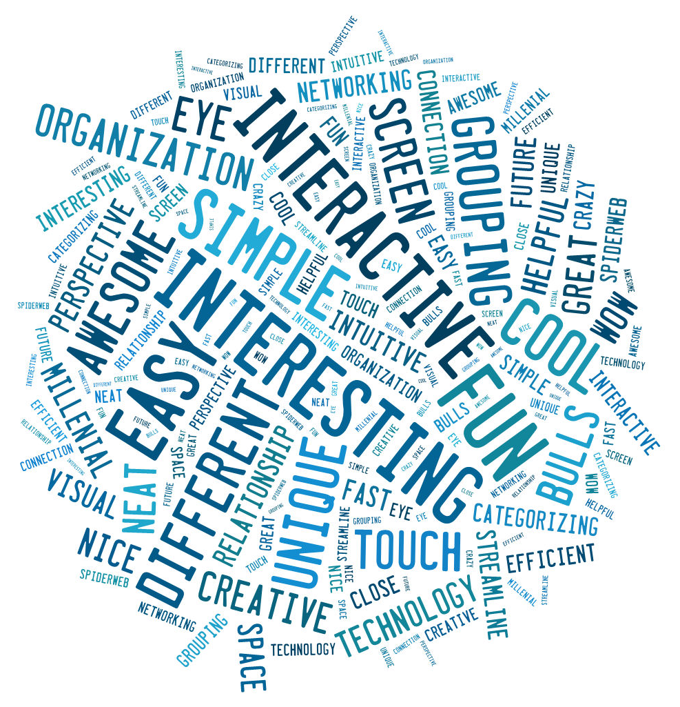
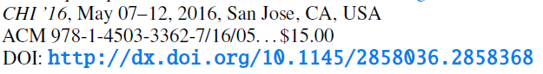
Evaluation of the Software

Slide 12
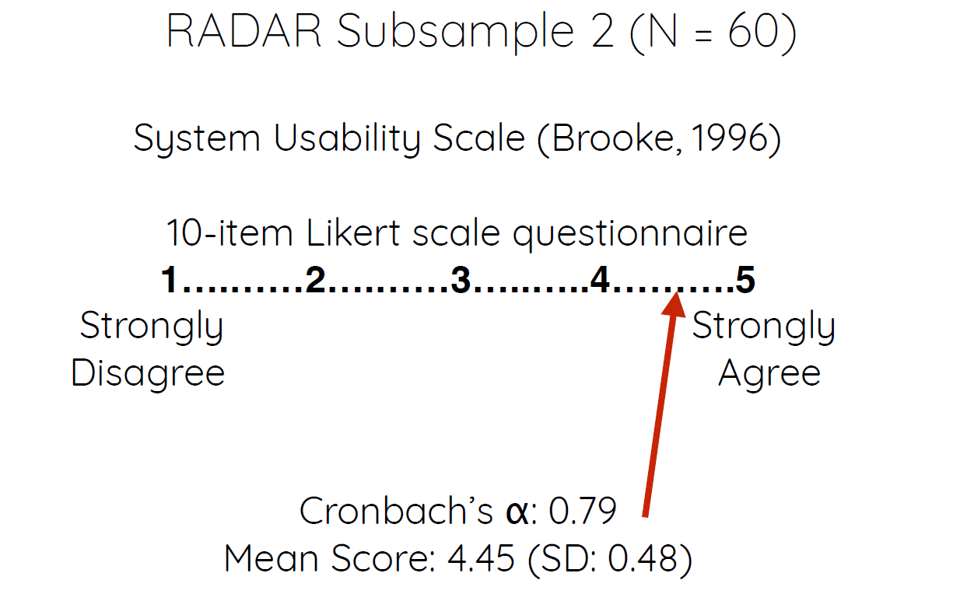
Usability

Slide 13
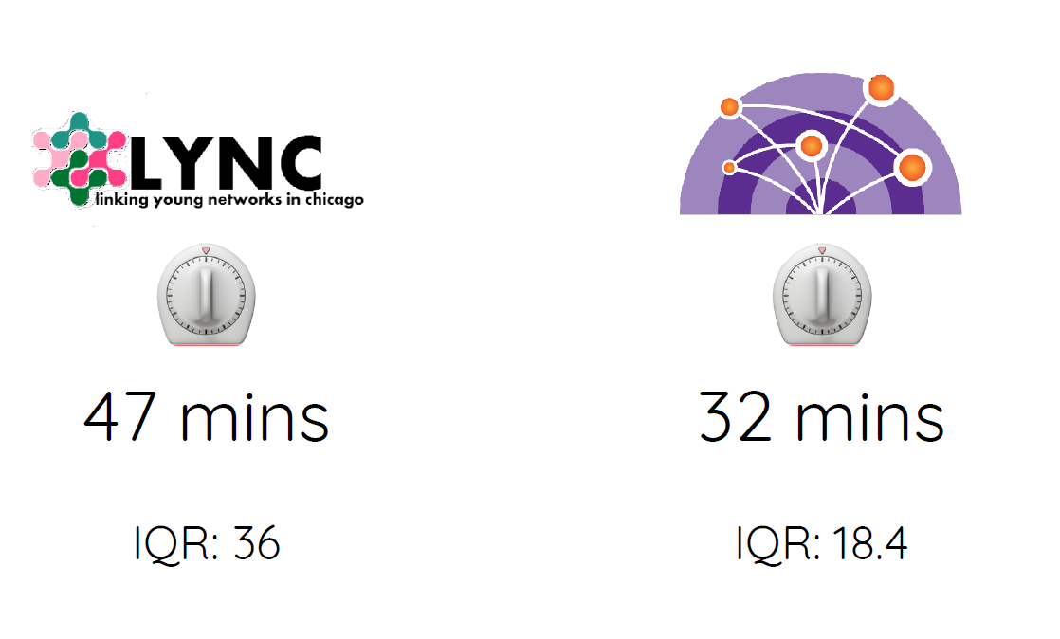
Efficiency

Slide 14
Project Team
Principal Investigators: Drs. Michelle Birkett and Gregory Phillips II
Co-Investigators: Drs. Patrick Janulis, Bernie Hogan, Noshir Contractor, and Michael Bass
Development Team: Joshua Melville, Steve McKellar, Rebecca Madsen, Jamie Chung, and Bryan Fox
Project Staff: Kate Banner, Shawna Davis, Elizabeth McConnell, and Balint Neray
Test Site Leaders: Drs. Natalie Crawford (Emory University) and Cui Yang (Johns Hopkins University)
Scientific Advisory Board: Drs. Brian Mustanski, Richard D’Aquila, Martin Everett, jimi adams, and Abel Kho
R01 DA042711

Slide 15
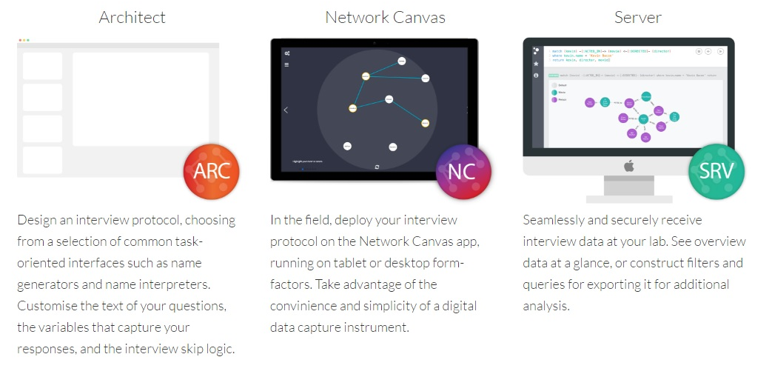



MPIs: Michelle Birkett & Gregory Phillips II

Slide 16
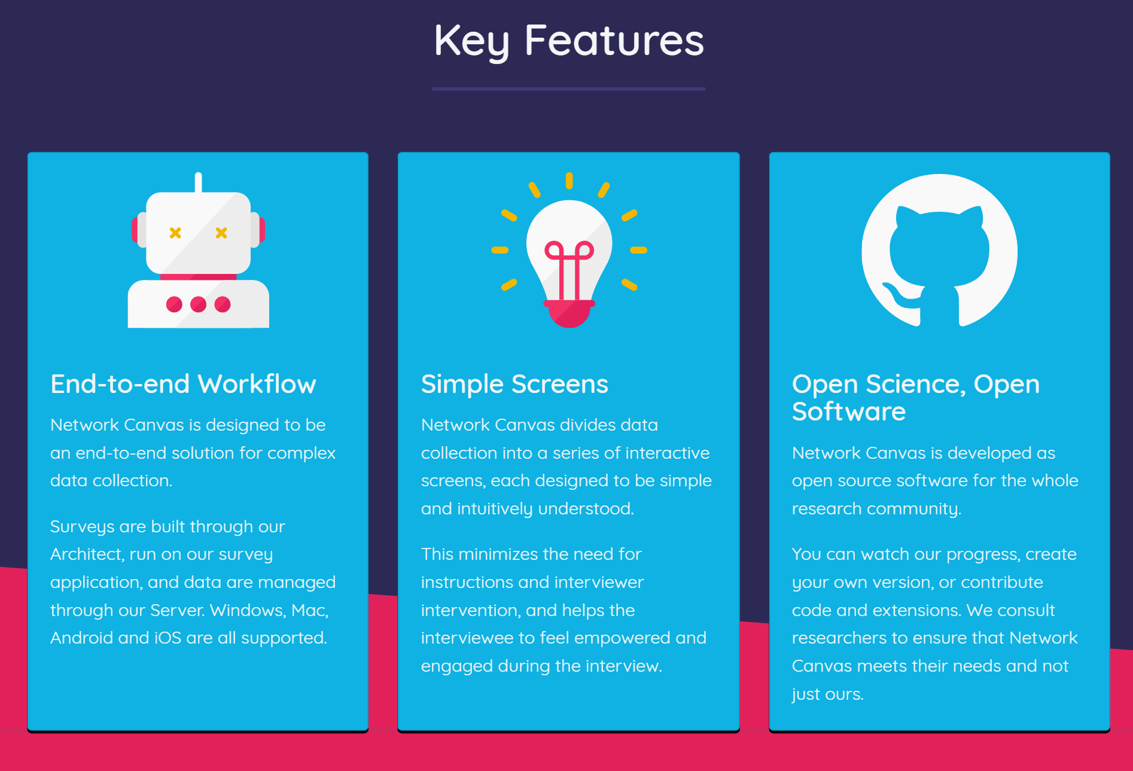

Slide 17
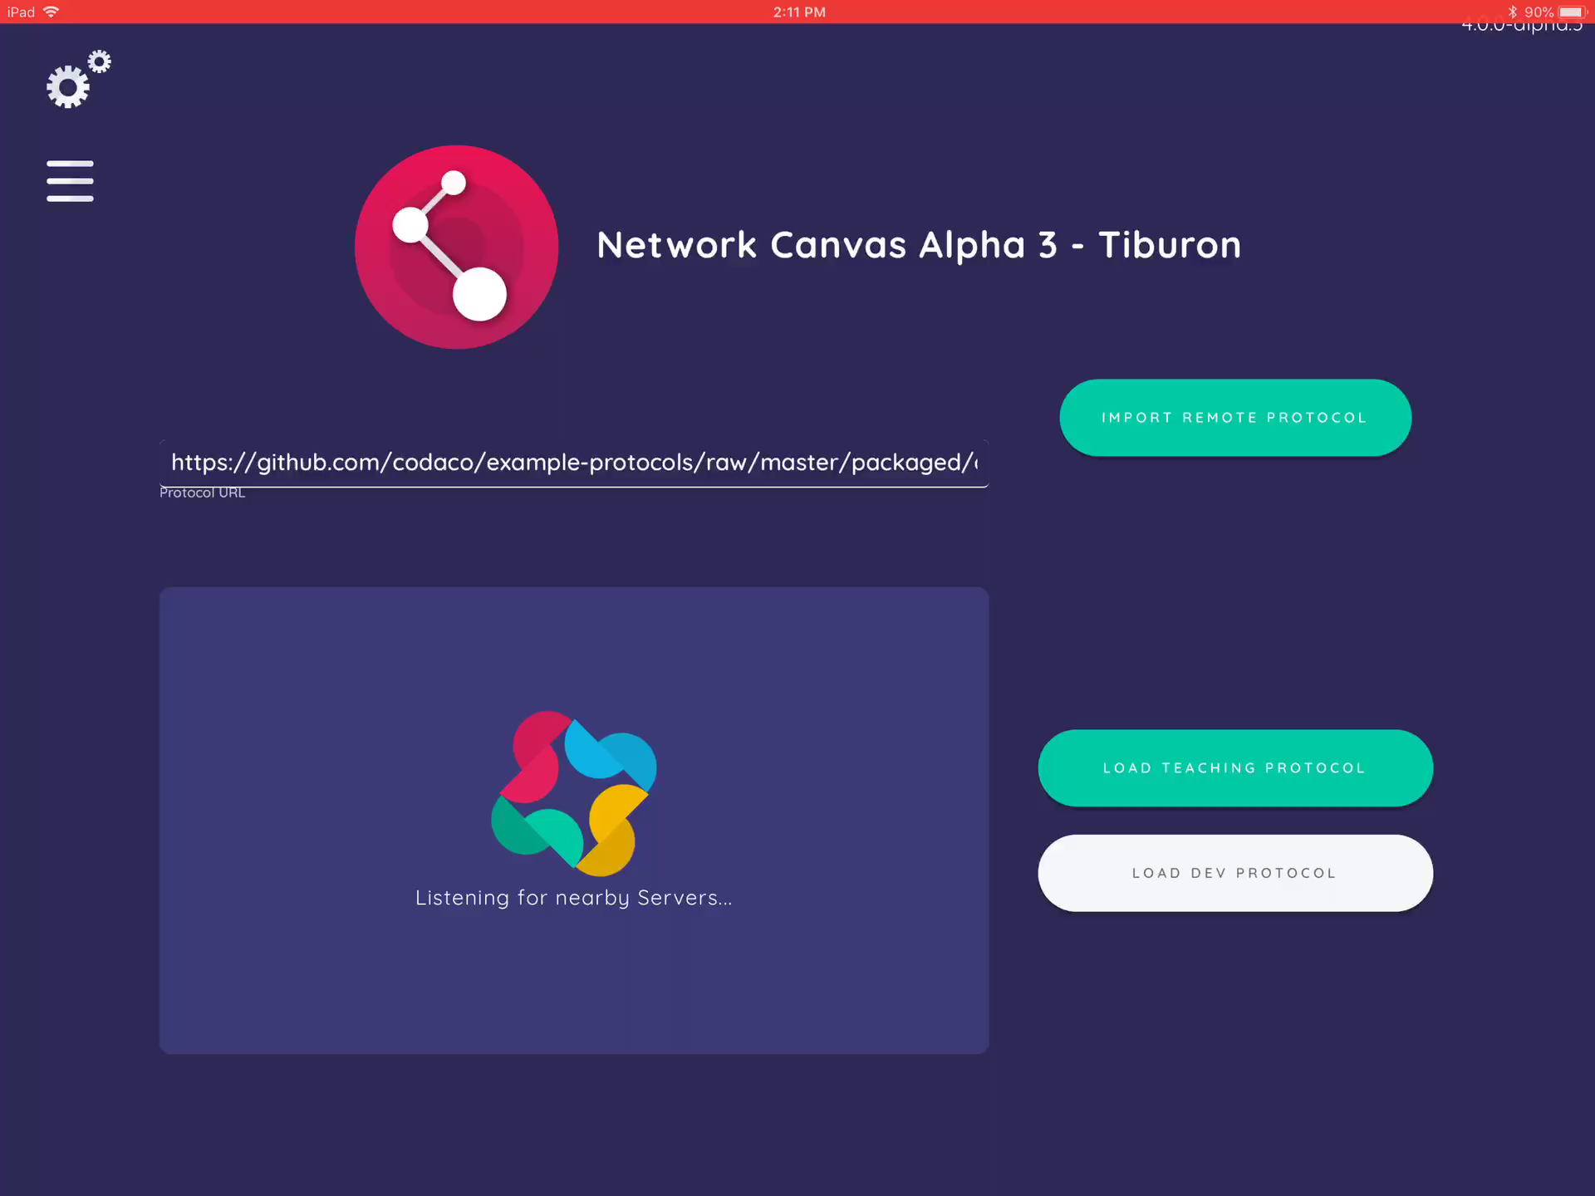

Slide 18
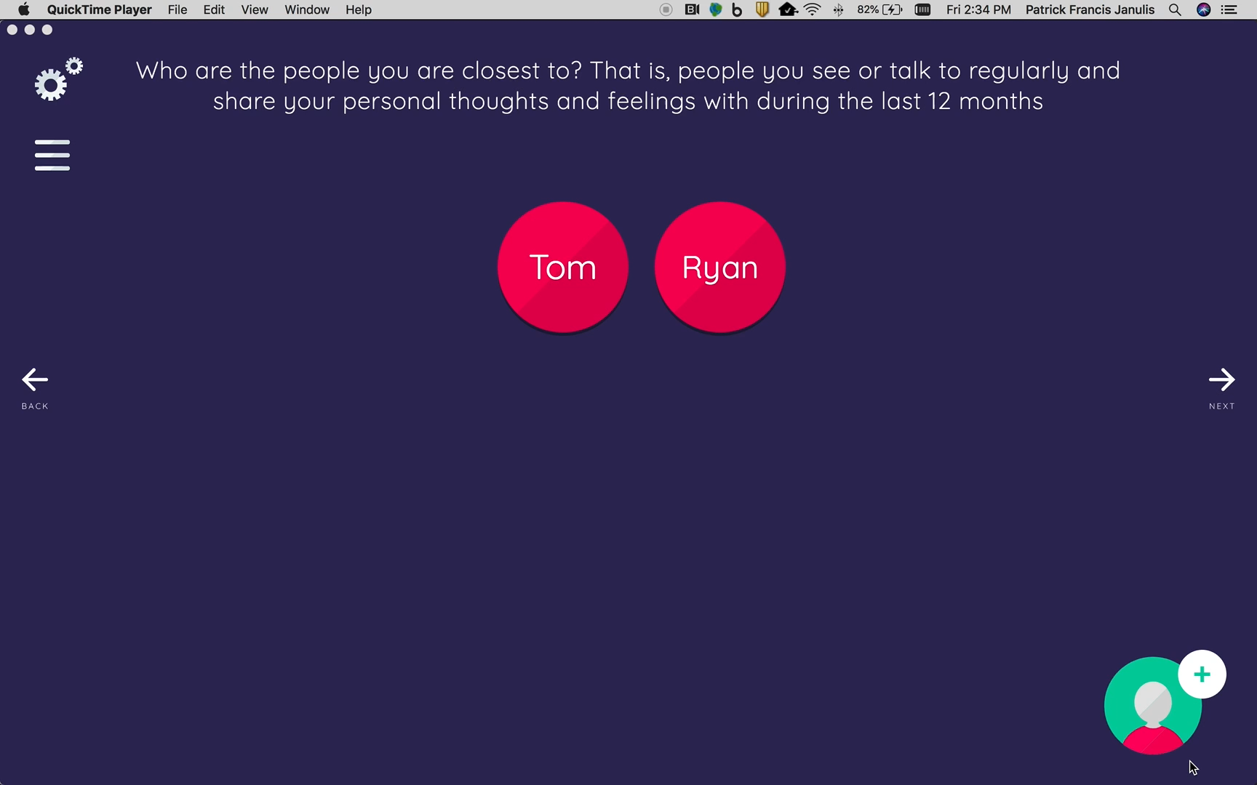

Slide 19
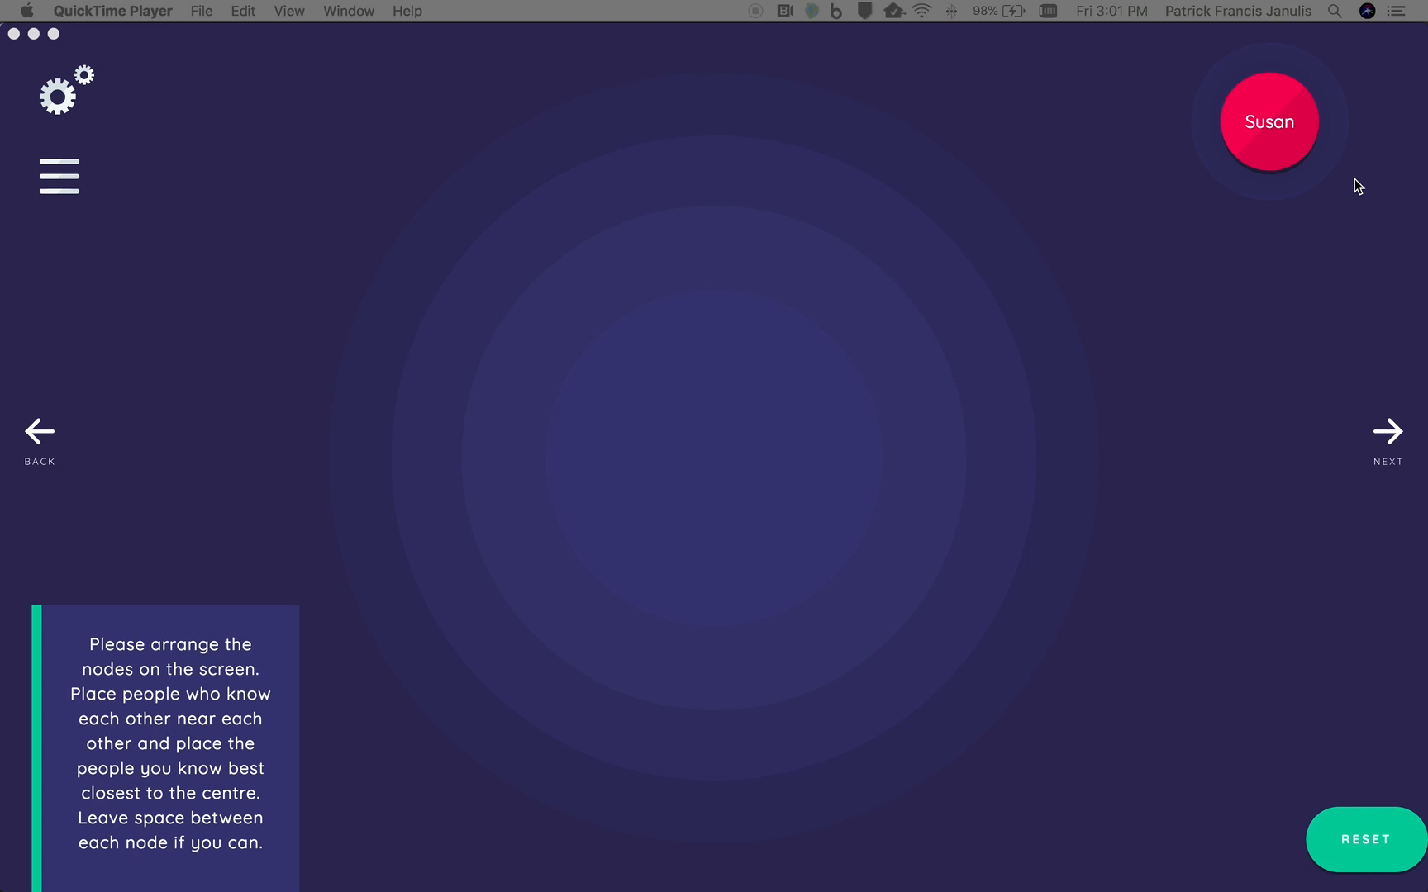

Slide 20
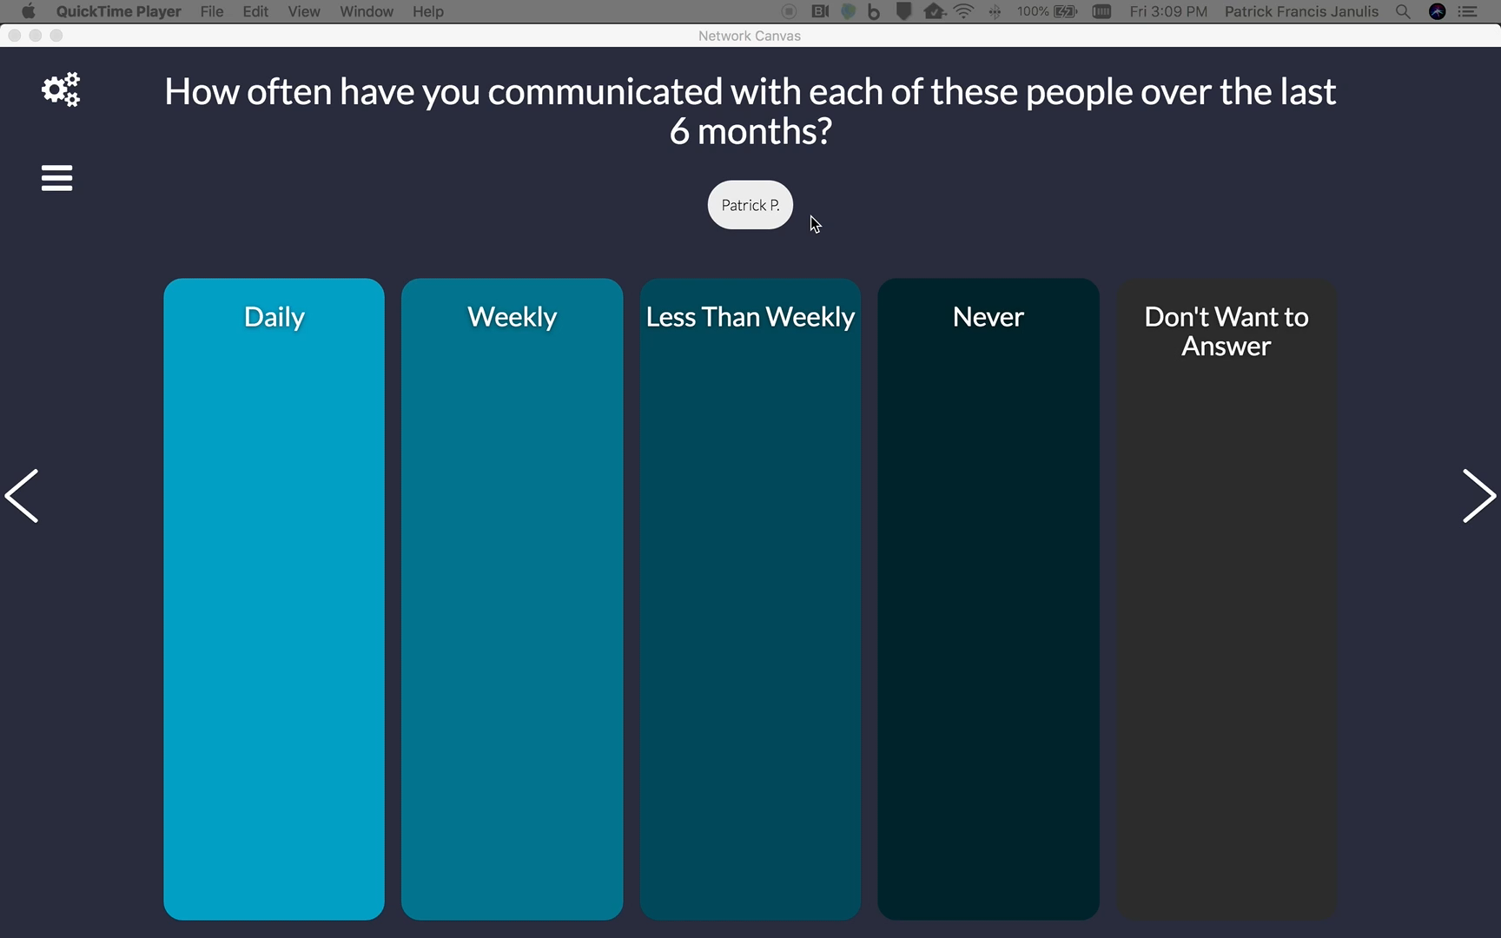

Slide 21
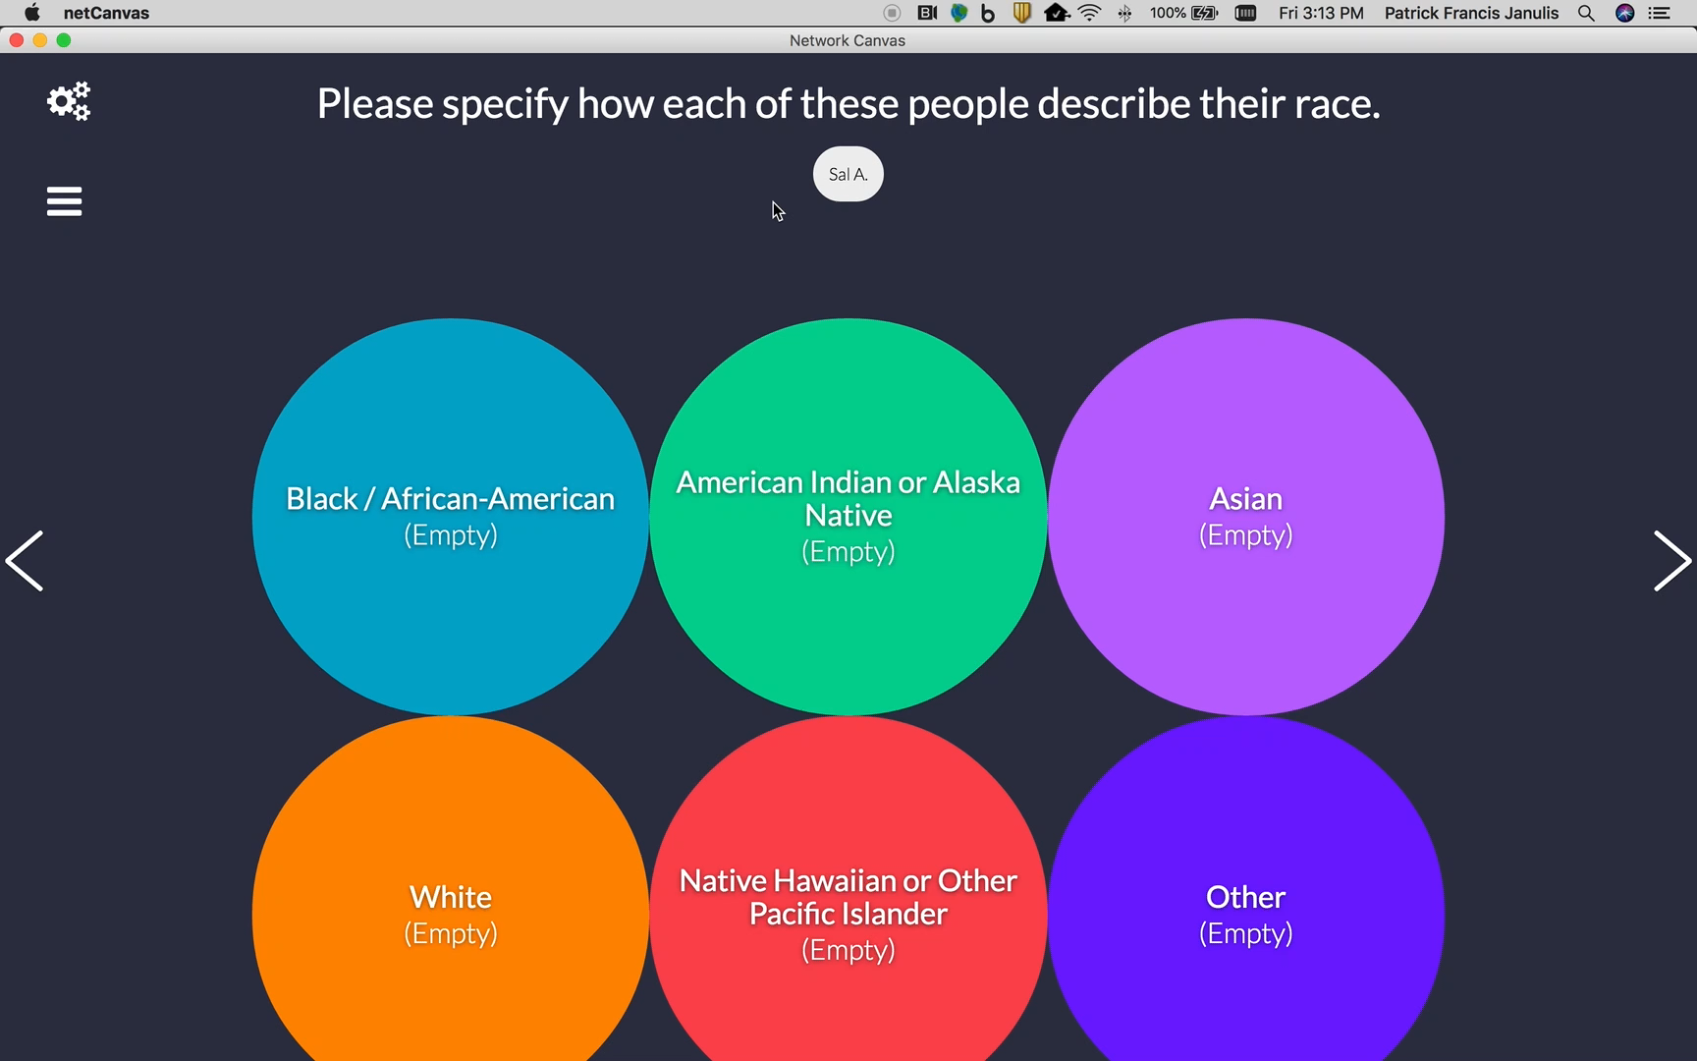

Slide 22

Timeline

Slide 23
Outreach
Conferences
Sunbelt, NASN, EUSN, APHA, CROI
Website
Online focus groups
Demo feedback sessions with investigators
Yearly community survey

Slide 24
Community Survey

Slide 25
Sustainment
NIH support
Workshops
Consultation
Strong community involvement

Slide 26
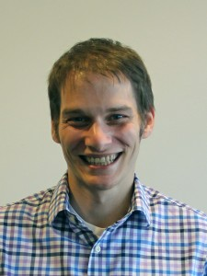
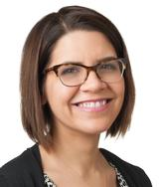

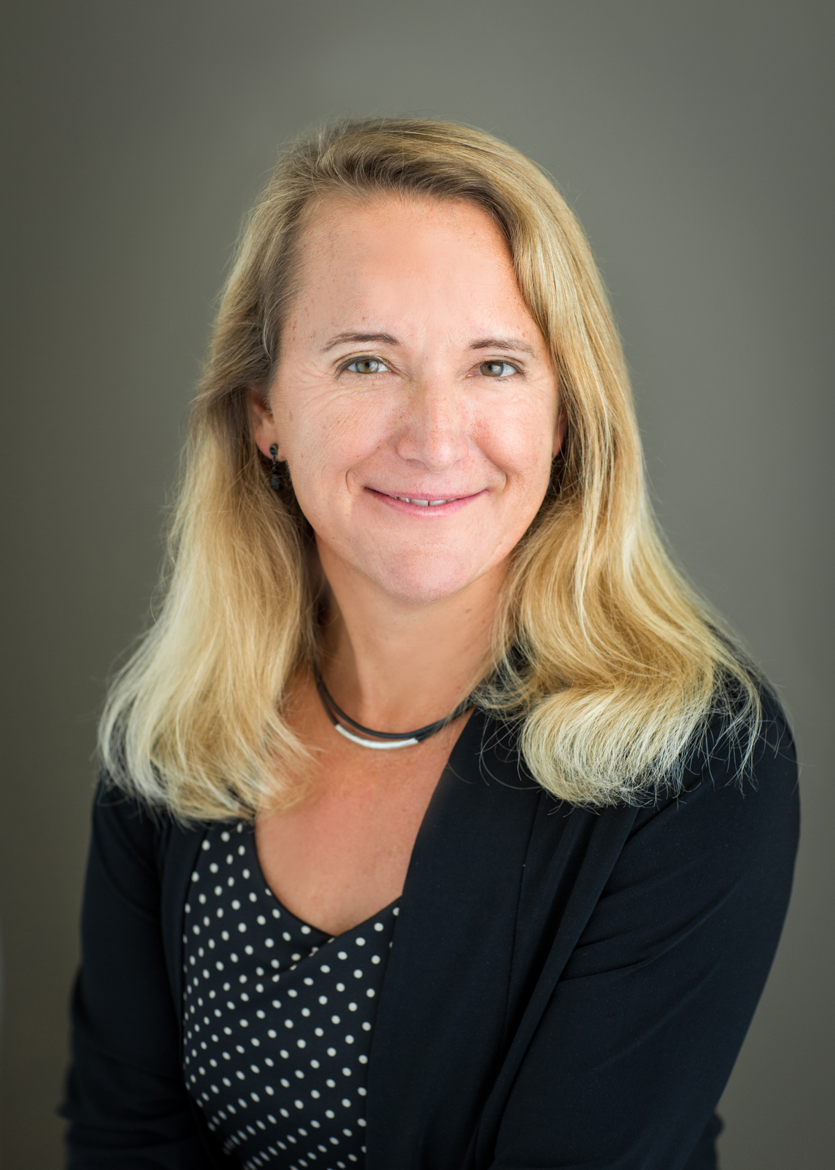
PUG
Principal Investigator
Develop a machine learning approach to match individuals across personal contact networks and validate it using a large existing dataset of young men who have sex with men (RADAR; U01 DA036939)
Create a graphical user interface to implement the approach as an add-on package to Network Canvas (R01 DA042711)
Patrick Janulis
Co-Investigators
Michelle Birkett
Gregory Phillips II
Lise Getoor
R21 LM012578

Slide 27
How can you get involved?
Keep an eye on our website
www.networkcanvas.com
Sign up for our mailing list to receive updates
Give us feedback

Slide 28
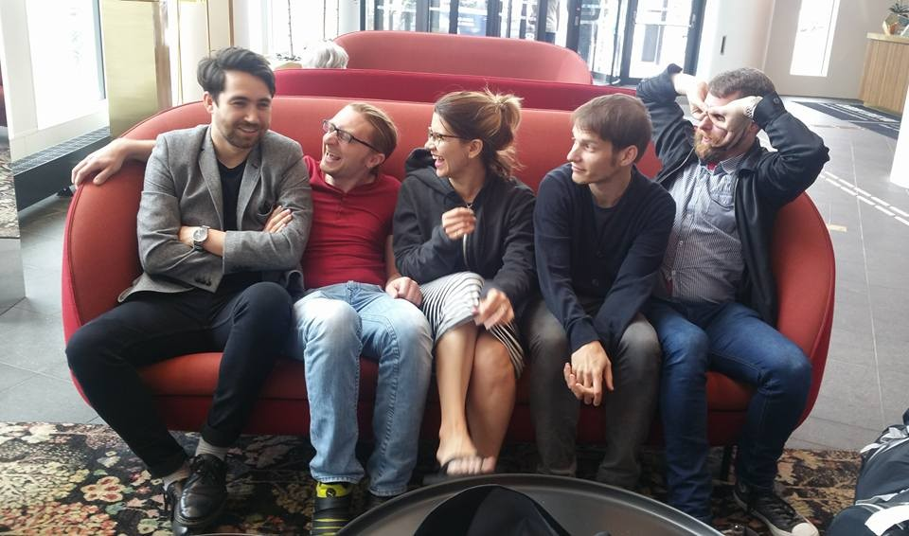
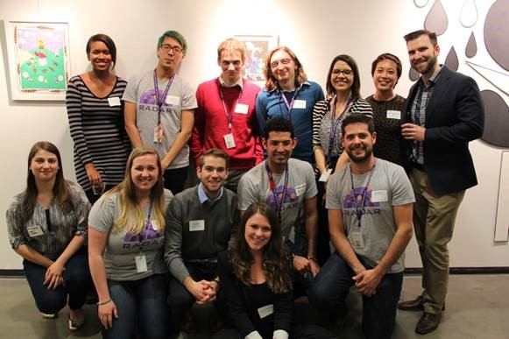
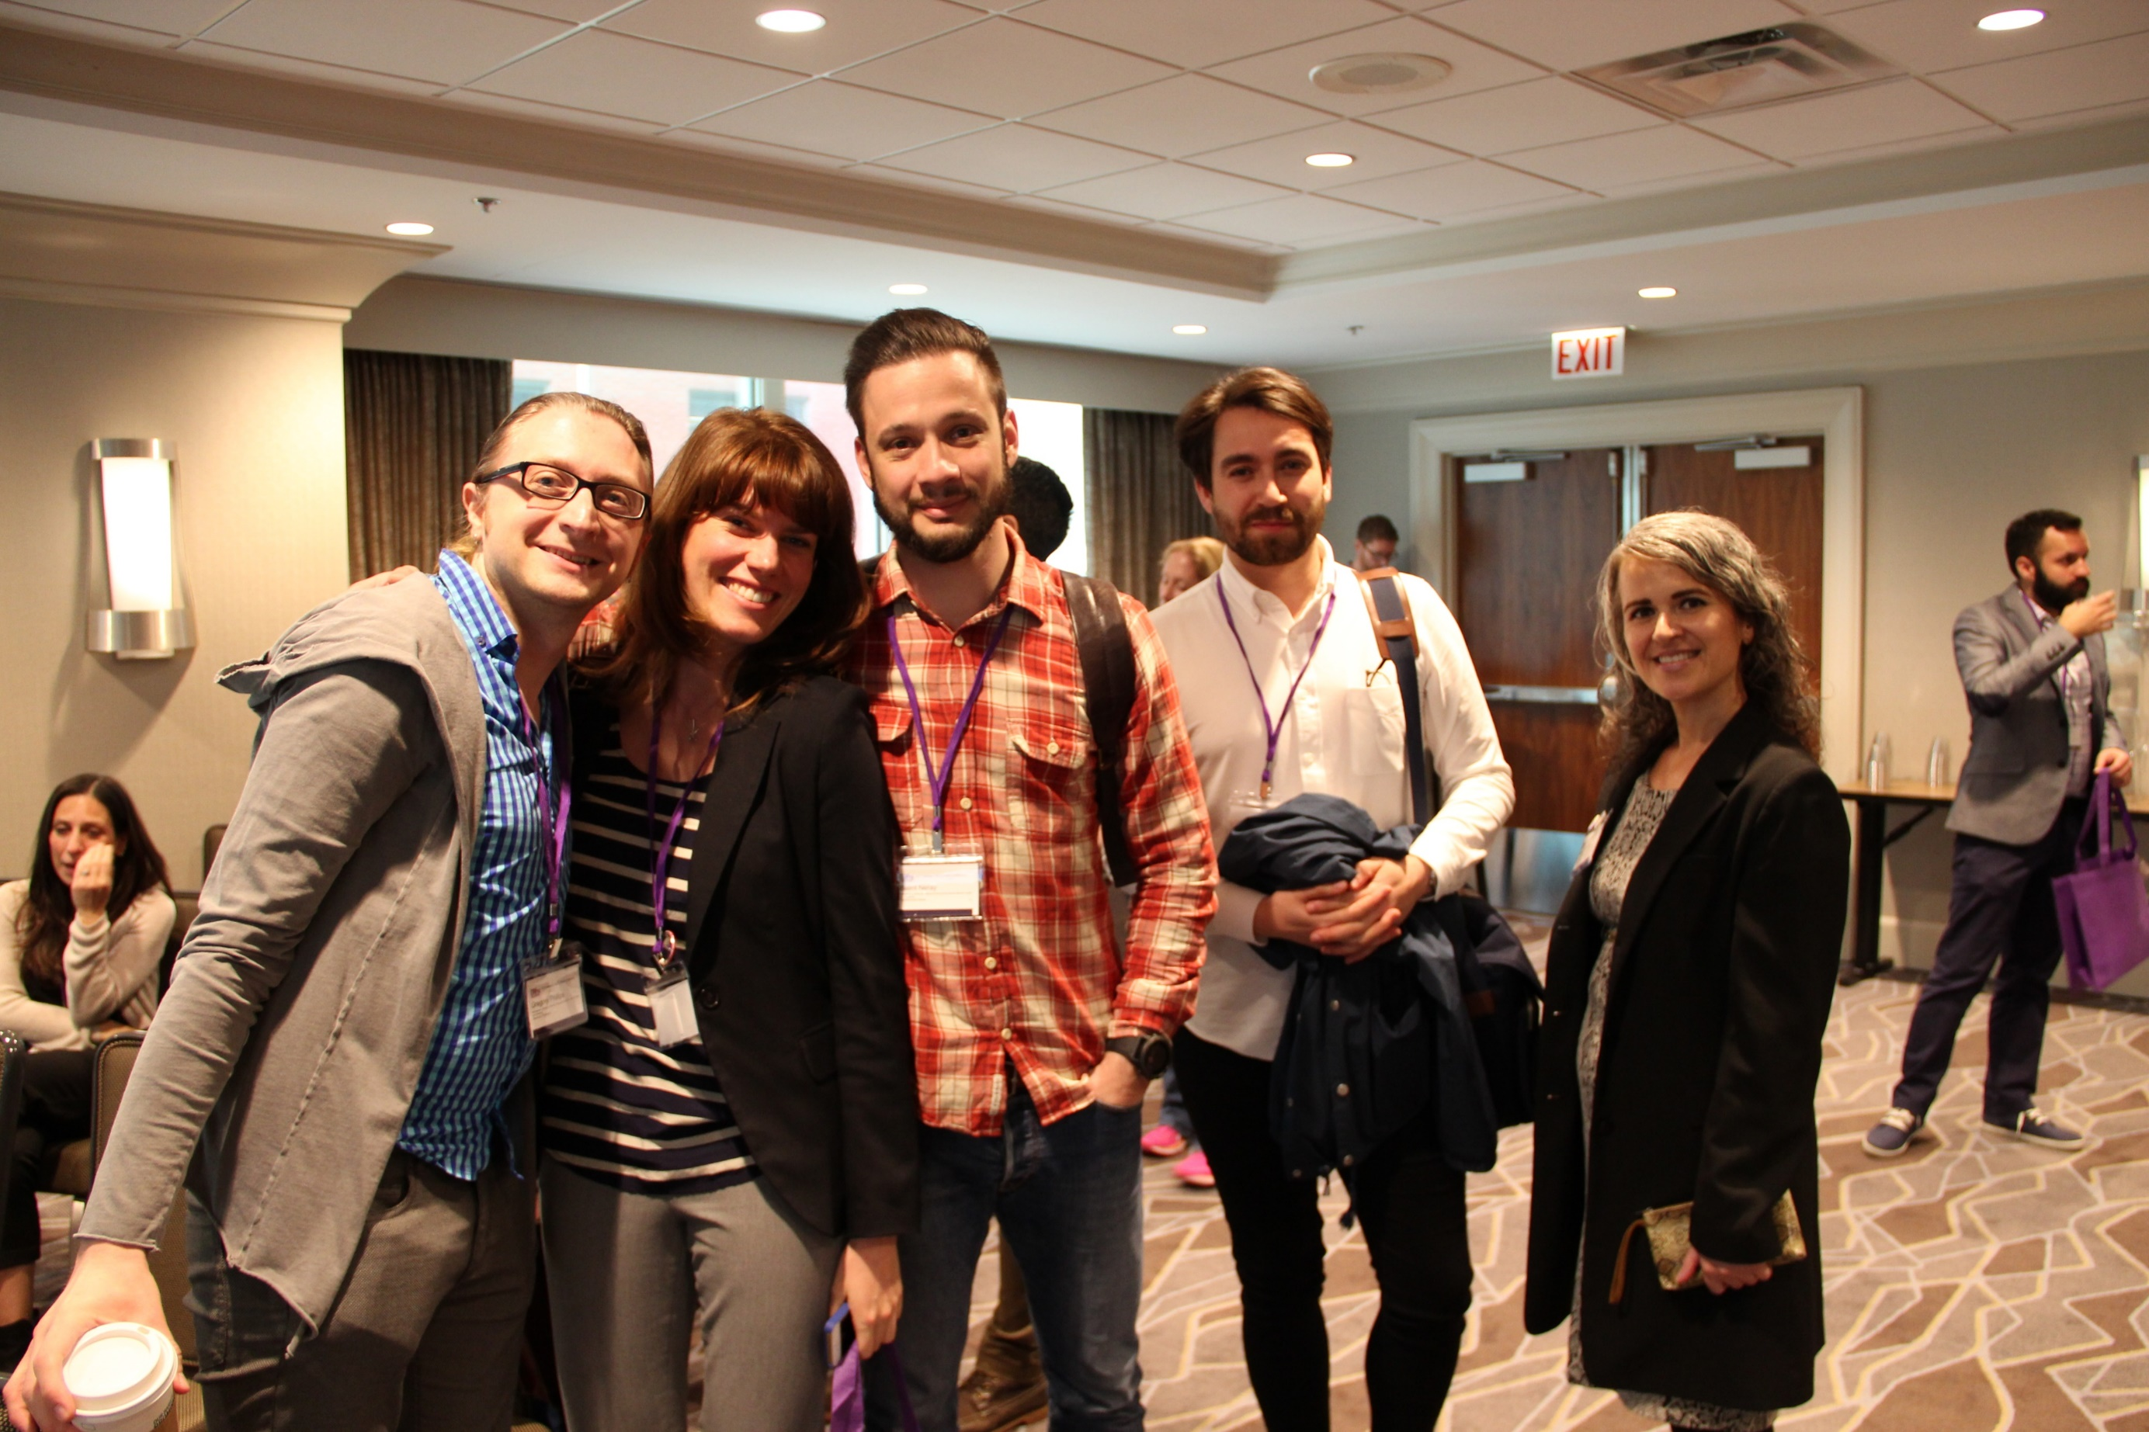
Thank you funders, institutional support, and staff!
Research was supported by:
R01 DA042711 (PIs: Birkett and Phillips)
U01 DA036939 (PI: Mustanski)
R21 LM012578 (PI: Janulis)
K08 DA037825 (PI: Birkett)
patrick.janulis@northwestern.edu
www.networkcanvas.com
www.patrickjanulis.com

